Slide 1
Grouping Students in Educational Settings
Speaker: Jim-An Tsai
Advisor: Jia-ling Koh
Author: Rakesh Agrawal, Behzad Golshan, Evimaria Terzi
Date: 2015/4/30
Source: KDD’14

Slide 2
Outline
1. Introduction
2. Framework
3. Experiment
4. Conclusion

Slide 3
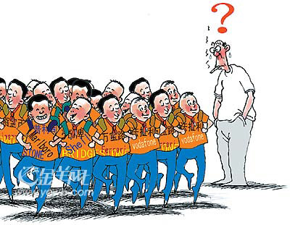
Introduction
How can we Group a large number of Students into sections so that the overall Gain for students is Maximized?

Slide 4
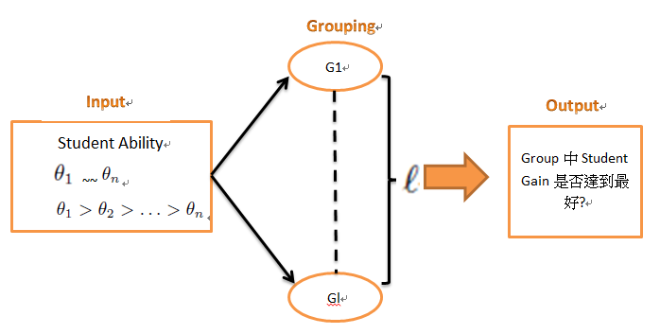
Introduction
1-Group Problem
ℓ-Groups problems

Slide 5
Outline
1. Introduction
2. Framework
3. Experiment
4. Conclusion

Slide 6
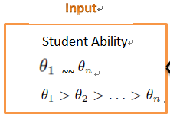
Framework
Leader
Follower
Notes:
舉個例子說明

Slide 7
Framework
Leader
Follower
Student Gain
Ignore leader

Slide 8
Framework

Slide 9
The Count1G problem
L&F algorithm
檢查是否滿足
Feasibility Constraint
滿足
Return

Slide 10
The Count1G problem
For example:
令 k = 3 (k值表一個group訂為多少人,即Group size)
Check 1
Check 2
Check 3
?
0.8+0.6
3 0.8
0.9
Check1 X
0.6+0.5
3 0.6
0.9
Check2 O
Return {1, 3, 4}

Slide 11
The CountℓG problem
It’s NP-complete problem.
Use IterL&F method to solve.
IterL&F is an iteration of L&F algorithm,
including max-IterL&F, min-IterL&F, any-IterL&F

Slide 12
The Value1G problem
Endpoints algorithm
檢查是否滿足
滿足
Get a lot of T
Return

Slide 13
The Value1G problem
For example:
令 k = 3 (k值表一個group訂為多少人,即Group size)
i = 1
= (0.9+0.5+0) / 3 = 0.466
Check1 X
i = 2
= (0.9+0.8+0) / 3 = 0.566
Check2 O
Have
T2 =
Return
= 0.566 – 0 = 0.566

Slide 14
The ValueℓG problem
It is still unresolved.
Use InterEndpoints to solve: is an iteration of Endpoints algorithm
Use RoundRobin to solve: creates k students at positions: 1, n/k+1, 2*(n/k)+1

Slide 15
Outline
1. Introduction
2. Framework
3. Experiment
4. Conclusion

Slide 16
Datasets
n =1024 students
Use randomly sampled from
(a)normal distribution
(b)uniform distribution
(c)pareto distribution

Slide 17
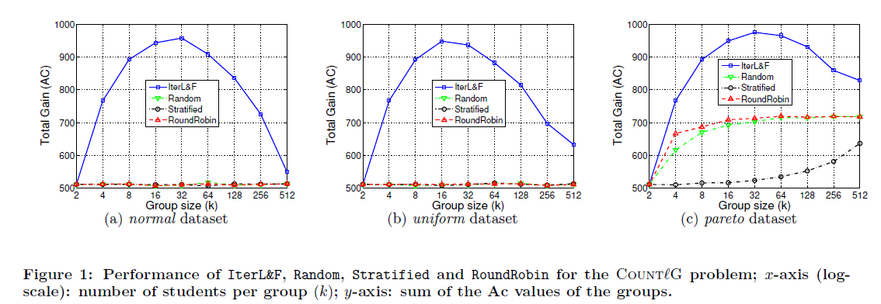
Experiment for CountℓG

Slide 18
Experiment for CountℓG

Slide 19
Check for 3type IterL&F

Slide 20
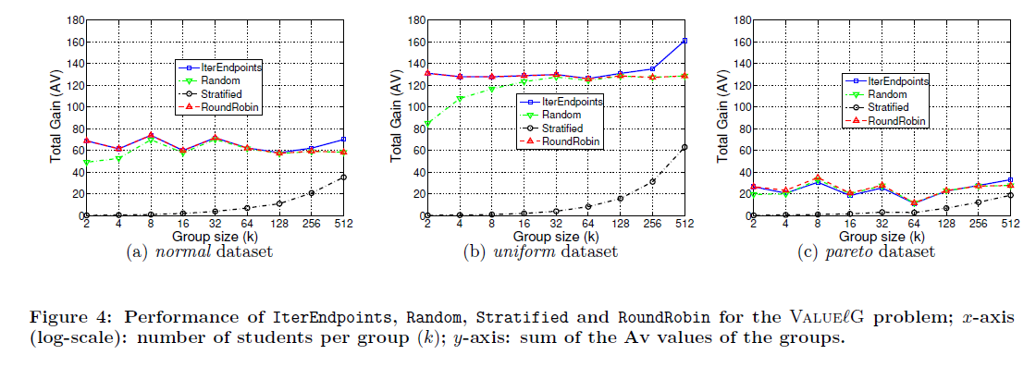
Experiment for ValueℓG

Slide 21
Experiment for ValueℓG

Slide 22
Outline
1. Introduction
2. Framework
3. Experiment
4. Conclusion

Slide 23
Conclusion
We proposed a formal framework for studying the socially important problem of grouping students in a large class into sections so that the gain aggregated over all the students is maximized.
Our experiments indicate that by appropriately choosing the definition of the gain function, it is possible to achieve different social goals.

Slide 24
Thanks for Listening

